Slide 1

Joins
M2-D3
Participate! The more engagement the better! You are NEVER interrupting me!

Slide 2
Objectives
Keys (Primary, Natural, Surrogate, Foreign)
Cardinality (1-1, 1-N, N-M)
SQL Joins (INNER AND LEFT JOIN)
Unions

Slide 3
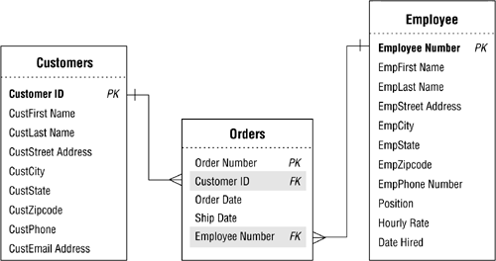
Database Keys
Keys are used to create relationships between two tables. A relationship in a relational database is an association between two tables.
A customer can be associated with an order. An order can be fulfilled by an employee.
A customerID in the Customer table is a key that connects a customer to the customerID in the Orders table.

Slide 4
Primary Keys
Primary Keys uniquely identify each row within a table. They cannot be duplicated within that table and cannot be null. It is typically a single column but can also be comprised of multiple columns.
CustomerID in the Customer table, OrderNumber in the Orders table, and EmployeeNumber in the Employee table are examples of primary keys

Slide 5
Foreign Keys
Foreign Keys exist in other tables and are used to reference a primary key in the source table. (This completes the linkage between the relationship)
CustomerID in the Orders table, is a Foreign Key. EmployeeNumber in the Orders Table is a Foreign Key

Slide 6
Natural Keys
Natural Keys are formed from values in the real world
(ex: What things can you think of that would guarantee uniqueness when identifying a person?)

Slide 7
Surrogate Keys
Surrogate Keys are artificially created by the application and identify a unique record.
Databases provide an autonumber (or sequence) that allows each new record inserted into a database to have a unique value it can be used as a primary key. Postgres → serial datatype

Slide 8
Cardinality
Cardinality refers to the maximum number of times that an instance in one entity can be associated with instances in a related entity, along with the minimum number of times it must be associated. Examples:
1 student can be enrolled in many classes (1 to many) 1 person can have 1 social security number (1 to 1) Multiple orders can consist of multiple products (many to many)

Slide 9
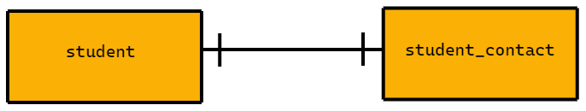
One-to-One (1:1) Cardinality
An entity on one table relates to a single entity on a second table.
A student can have one student contact, and a student contact can only be related to one student.
Requires no extra tables, a foreign key can be used either way without duplicating data.

Slide 10

One-to-Many (1:N) Cardinality
An entity on one table can relate to multiple entities on a second table.
A School can have multiple classes, but a class can only be related to one school. .
Requires no extra table, the table on the 1 side’s primary key can be added to the table with the M relationships without duplication of data

Slide 11
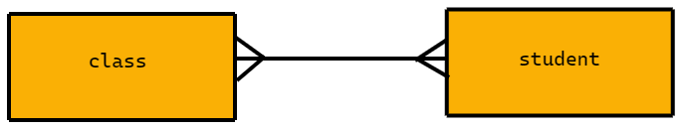
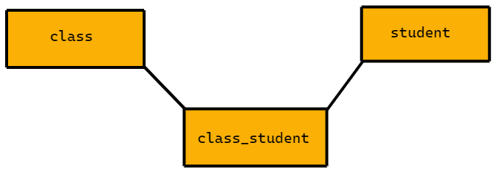
Many-to-Many (M:N) Cardinality
Each entity on a table can relate to multiple entities on a second table.
A class can have multiple students, and a student may have multiple classes.
Requires a join table that contains just the primary keys of both tables to avoid duplicating data
A Many-to-Many Relationship REQUIRES a join table

Slide 12
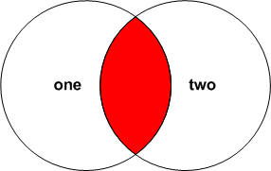
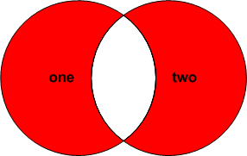
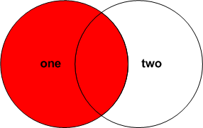
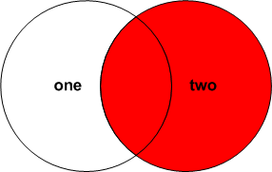
Joins
SQL JOINs allow us to create queries that produce data from one or more tables.
Related records are "joined" into a single result.
Joins are referred to as INNER and OUTER.
The tables involved in a JOIN are referred to as LEFT and RIGHT.
INNER
OUTER
LEFT
RIGHT

Slide 13
Tables
Table one
number | description
100 | ONE - 100
101 | ONE - 101
102 | ONE - 102
103 | ONE - 103
104 | ONE - 104
105 | ONE - 105
990 | ONE-BOTH - 990
991 | ONE-BOTH - 991
992 | ONE-BOTH - 992
993 | ONE-BOTH - 993
994 | ONE-BOTH - 994
995 | ONE-BOTH - 995
Table two
number | description
200 | TWO - 200
201 | TWO - 201
202 | TWO - 202
203 | TWO - 203
204 | TWO - 204
205 | TWO - 205
990 | TWO-BOTH - 990
991 | TWO-BOTH - 991
992 | TWO-BOTH - 992
993 | TWO-BOTH - 993
994 | TWO-BOTH - 994
995 | TWO-BOTH - 995

Slide 14
Inner Join
(Default)
Tables joined on number
one.number | one.description | two.number | two.description
100 | ONE - 100 | null | null
101 | ONE - 101 | null | null
102 | ONE - 102 | null | null
103 | ONE - 103 | null | null
104 | ONE - 104 | null | null
105 | ONE - 105 | null | null
990 | ONE-BOTH - 990 | 990 | TWO-BOTH - 990
991 | ONE-BOTH - 991 | 991 | TWO-BOTH - 991
992 | ONE-BOTH - 992 | 992 | TWO-BOTH - 992
993 | ONE-BOTH - 993 | 993 | TWO-BOTH - 993
994 | ONE-BOTH - 994 | 994 | TWO-BOTH - 994
995 | ONE-BOTH - 995 | 995 | TWO-BOTH - 995
null | null | 200 | TWO - 200
null | null | 201 | TWO - 201
null | null | 202 | TWO - 202
null | null | 203 | TWO - 203
null | null | 204 | TWO - 204
null | null | 205 | TWO - 205
SELECT one.number AS one_number, one.description as one_description, two.number as two_number, two.description as two_description
FROM one
JOIN two ON one.number = two.number
Ex: Customer Data Table and MarketingLeads Table where the person exists in both

Slide 15
Left Join
( Left Outer Join )
Tables joined on number
on.number | one.description | two.number | two.description
100 | ONE - 100 | null | null
101 | ONE - 101 | null | null
102 | ONE - 102 | null | null
103 | ONE - 103 | null | null
104 | ONE - 104 | null | null
105 | ONE - 105 | null | null
990 | ONE-BOTH - 990 | 990 | TWO-BOTH - 990
991 | ONE-BOTH - 991 | 991 | TWO-BOTH - 991
992 | ONE-BOTH - 992 | 992 | TWO-BOTH - 992
993 | ONE-BOTH - 993 | 993 | TWO-BOTH - 993
994 | ONE-BOTH - 994 | 994 | TWO-BOTH - 994
995 | ONE-BOTH - 995 | 995 | TWO-BOTH - 995
null | null | 200 | TWO - 200
null | null | 201 | TWO - 201
null | null | 202 | TWO - 202
null | null | 203 | TWO - 203
null | null | 204 | TWO - 204
null | null | 205 | TWO - 205
SELECT one.number AS one_number, one.description as one_description, two.number as two_number, two.description as two_description
FROM one
LEFT JOIN two ON one.number = two.number
Ex: Get ALL Customer Data regardless of whether they exist in MarketingLeads table but if they exist in MarketingLeads Table it will retrieve that information as well where there is a match

Slide 16
Right Join
( Right Outer Join )
Tables joined on number
on.number | one.description | two.number | two.description
100 | ONE - 100 | null | null
101 | ONE - 101 | null | null
102 | ONE - 102 | null | null
103 | ONE - 103 | null | null
104 | ONE - 104 | null | null
105 | ONE - 105 | null | null
990 | ONE-BOTH - 990 | 990 | TWO-BOTH - 990
991 | ONE-BOTH - 991 | 991 | TWO-BOTH - 991
992 | ONE-BOTH - 992 | 992 | TWO-BOTH - 992
993 | ONE-BOTH - 993 | 993 | TWO-BOTH - 993
994 | ONE-BOTH - 994 | 994 | TWO-BOTH - 994
995 | ONE-BOTH - 995 | 995 | TWO-BOTH - 995
null | null | 200 | TWO - 200
null | null | 201 | TWO - 201
null | null | 202 | TWO - 202
null | null | 203 | TWO - 203
null | null | 204 | TWO - 204
null | null | 205 | TWO - 205
SELECT one.number AS one_number, one.description as one_description, two.number as two_number, two.description as two_description
FROM one
RIGHT JOIN two ON one.number = two.number
Ex: Get ALL MarketingLeads data regardless of whether they exist in customer table but if they exist in customer table it will retrieve that information as well where there is a match

Slide 17
Union
A SQL UNION combines the results of two or more queries into a single result set.
The number of columns involved must match exactly and data types must be identical.
Duplicate rows are removed.
A good example for this is a database that might have faculty and students separated into different tables but we want to return all people who attend or work at a school.
SELECT expression1, expression2, ... expression_n FROM tables [WHERE conditions] UNION SELECT expression1, expression2, ... expression_n FROM tables [WHERE conditions]

Slide 18
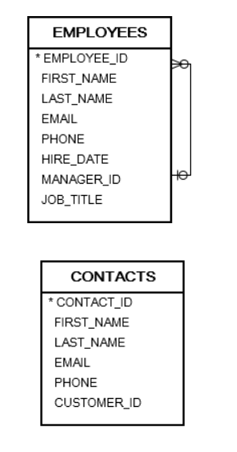
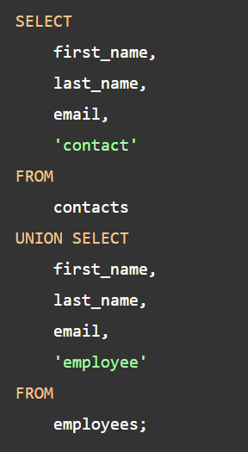
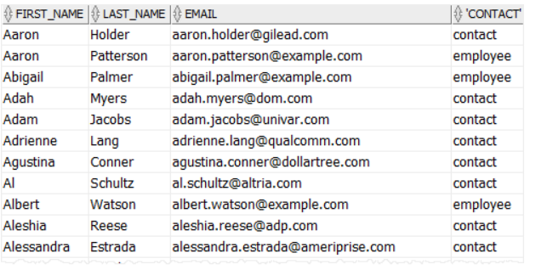
Union Example:

Slide 19
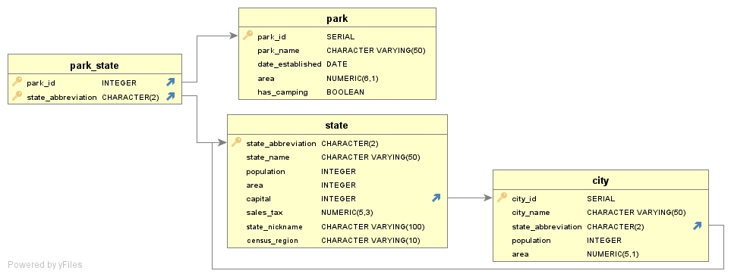
UnitedStatesDB

Slide 20
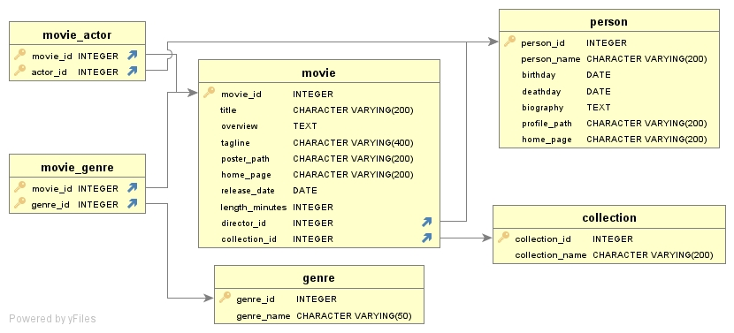
MovieDB

Slide 21
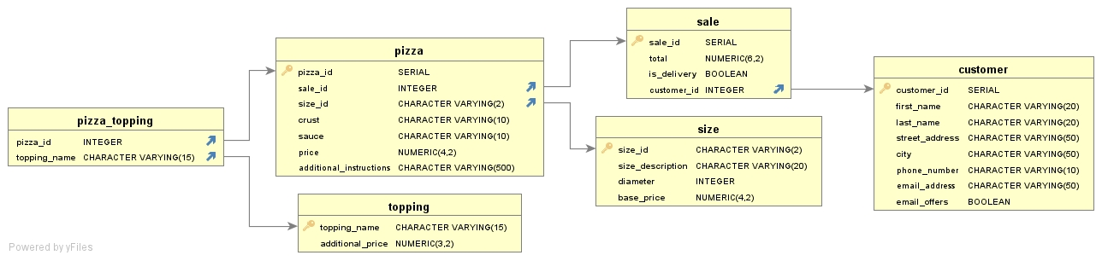
Pizza Shop

